Slide 1

Pathfinding Visualizer
Project
Kalinga Institute of Industrial Technology
By :
Sibonakaliso Mdlovu - 2128140
Ankit Kumar Yadav - 2128144
Aaditya Kumar Mani - 2128145

Slide 2
contents
Introduction
Problem Statement
Algorithms Overview
System Design
Methodology
Implementation
Results and Analysis
Conclusion and Future Scope
Acknowledgments

Slide 3
Introduction
Pathfinding is a crucial concept in computer science and artificial intelligence.
It involves determining the optimal path between two points in a given environment.
This project explores and implements various pathfinding algorithms, including Dijkstra’s Algorithm, A* Search, Depth-First Search (DFS), Breadth-First Search (BFS) & Greedy Best-First Search
The objective is to analyze their performance and practical applications through visualization.
Applications include robotics, gaming, logistics, and network routing.

Slide 4
Problem Statement
Core Problem : Determining the optimal path between two points in various environments.
Project Goals :
Implement classical pathfinding algorithms like Dijkstra’s Algorithm, A* Search, BFS, DFS, and Greedy Best-First Search.
Evaluate their performance based on time complexity, space complexity, and solution quality.
Develop a visualization tool to demonstrate the algorithms' behavior and results.
Applications : ​
Navigation (Google Maps, Delivery Apps, etc)
Robotics: Efficient navigation in dynamic environments.
Gaming: NPC movement and level design.

Slide 5
Algorithm Review
Depth-First Search (DFS):
Explores as deep as possible before backtracking.
Uses a stack (LIFO).
Time Complexity: O(V + E).
Breadth-First Search (BFS):
Explores all neighbors before moving deeper.
Uses a queue (FIFO).
Time Complexity: O(V + E).
Dijkstra’s Algorithm:
Finds the shortest path in weighted graphs.
Utilizes a priority queue for node selection.
Time Complexity: O(E log V).
A Search:*
Combines actual cost (g) and heuristic (h)Complete and optimal with an admissible heuristic.
Time Complexity: O(E log V).
Greedy Best-First Search:
Prioritizes nodes with the lowest heuristic value (h).
Fast but not always optimal.
Time Complexity: O(E log V).

Slide 6
System Design
Tools and Technologies Used:
Programming Language: Python (v3.10 and above).
Library: Pygame for visualization.
IDE: Visual Studio Code.
Components:
Grid Representation:
Nodes with attributes: cost, state, heuristic, parent, etc.
Frontier Management:
Implemented using stacks, queues, or priority queues
Visualization Tool:
Step-by-step display of pathfinding process.
Highlights optimal path and explored nodes
System Architecture:
Code organized into modules for:
Node and Grid models.
Algorithm implementations.
Visualization and user interaction.
Design Constraints:
Efficient handling of large grids.
Intuitive user interface for customization.

Slide 7
Methodology
Grid Representation: The grid is modeled as a 2D array of nodes.
Each node has attributes:
State: Position in the grid.
Cost: Weight of traversing the node.
Parent: Reference to the previous node in the path.
Heuristic: Estimated cost to the goal (used in A* and GBFS).
Frontier Management:
Different structures based on the algorithm:
Stack (DFS),Queue (BFS), Priority Queue (A*, Dijkstra’s, GBFS).
Algorithm Workflow:
Initialize the start node and add it to the frontier.
Expand nodes based on the algorithm's strategy.
Track explored nodes to avoid re-processing.
Stop when the goal node is reached or the frontier is empty.
Visualization:
Dynamic step-by-step display of the search process.
Highlights explored nodes, optimal paths, and intermediate states.

Slide 8
Implementation
Code Structure:
Node and Grid Models:
Nodes store state, cost, heuristic, parent, etc.
Grid manages nodes and neighbors.
Frontiers: Stack, Queue, Priority Queue.
Algorithms: Implemented modularly for flexibility and testing.
Visualization Tool:
Built using Pygame.
Features:
Dynamic exploration.
Highlighted optimal paths and explored nodes.

Slide 9
RESult & analysis
Performance Metrics:
Time Complexity:
DFS/BFS: O(V + E).
A*/Dijkstra’s/Greedy: O(E log V).
Space Complexity:
Depends on frontier size (O(V) in the worst case).
Algorithm Comparisons:
A* Search: Best for balanced performance and accuracy.
Dijkstra’s: Reliable for weighted graphs but slower.
BFS: Optimal for unweighted graphs.
Greedy: Fast but may return suboptimal paths.
DFS: Inefficient for large grids.
Visualization Results:
Graphical comparisons showcasing explored nodes and optimal paths for various grid scenarios.

Slide 10
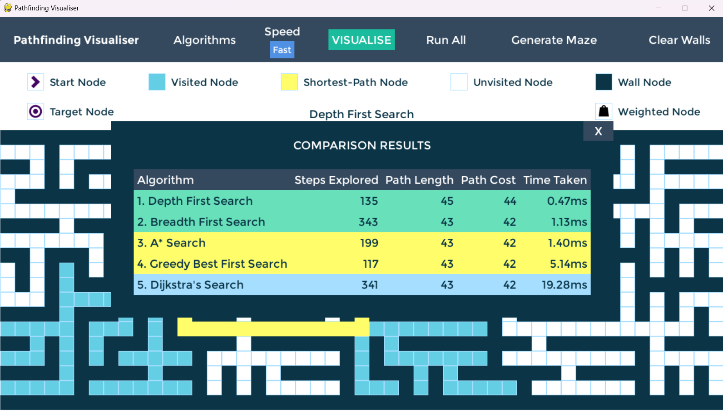
Result & Analysis

Slide 11
Conclusion and Future Scope
Conclusion:
Analyzed theoretical and practical aspects of major pathfinding algorithms.
Observed A* Search as the most efficient and accurate with an admissible heuristic.
Developed a user-friendly visualization tool.
Future Scope:
Advanced Techniques: Hierarchical Pathfinding, Potential Field Methods.
Dynamic Environments: Handle changing obstacles and goals.
Multi-Agent Systems: Optimize paths for multiple agents.
Real-World Applications: Autonomous vehicles, robotics, logistics.
Machine Learning Integration: Adaptive heuristics for improved efficiency.

Slide 12
Thank You
Kalinga Institute of Industrial Technology
Project Submitted to Soumya Sanket Patra

Slide 13
Refrences
[1] Brown, M. and Sedgewick, R. (1985). "Techniques for algorithm animation." IEEE Software, MIT Press, pp. 2:28-39.
[2]Yngvi, Halldorsson, K. (2006). "Improved heuristics for optimal Pathfinding on Game maps." In AIIDE, pp. 9-14.
[3]Krishnaswamy Nikhil. "Comparison of Efficiency in Pathfinding Algorithms in Game Development." Retrieved from https://via.library.depaul.edu/tr/10.
[4]Victor Martell Aron Sandberg (2016). "Performance Evaluation of A* Algorithms." Thesis no: BCS-2016-07.
[5]Chan, Simon Yew Meng, et al. (2016). "An experiment on the performance of shortest path algorithm." pp. 7-12.

